Slide 1
GPT: Generative Pre-trained Transformer
Slides adapted are adapted from various sources including from D. Hoiem, S. Diao, and Z. Li of U. of Illinois.
Slides are adopted from Advanced NLP course at UMass.

Slide 2
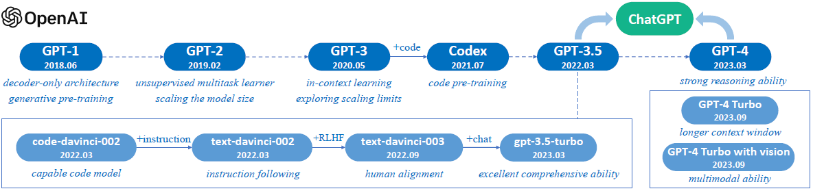
History of OpenAI GPT models

Slide 3
History of OpenAI GPT models

Slide 4
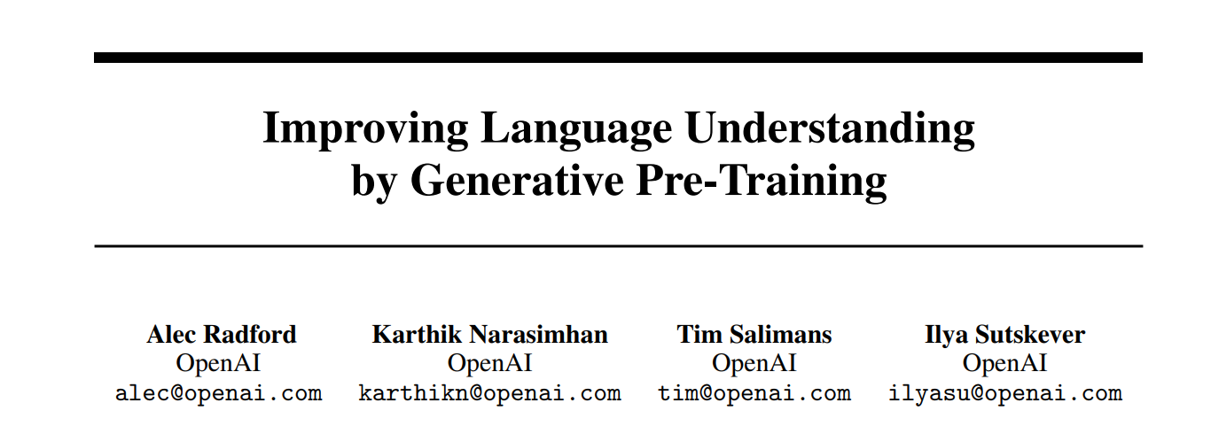
https://cdn.openai.com/research-covers/language-unsupervised/language_understanding_paper.pdf

Slide 5
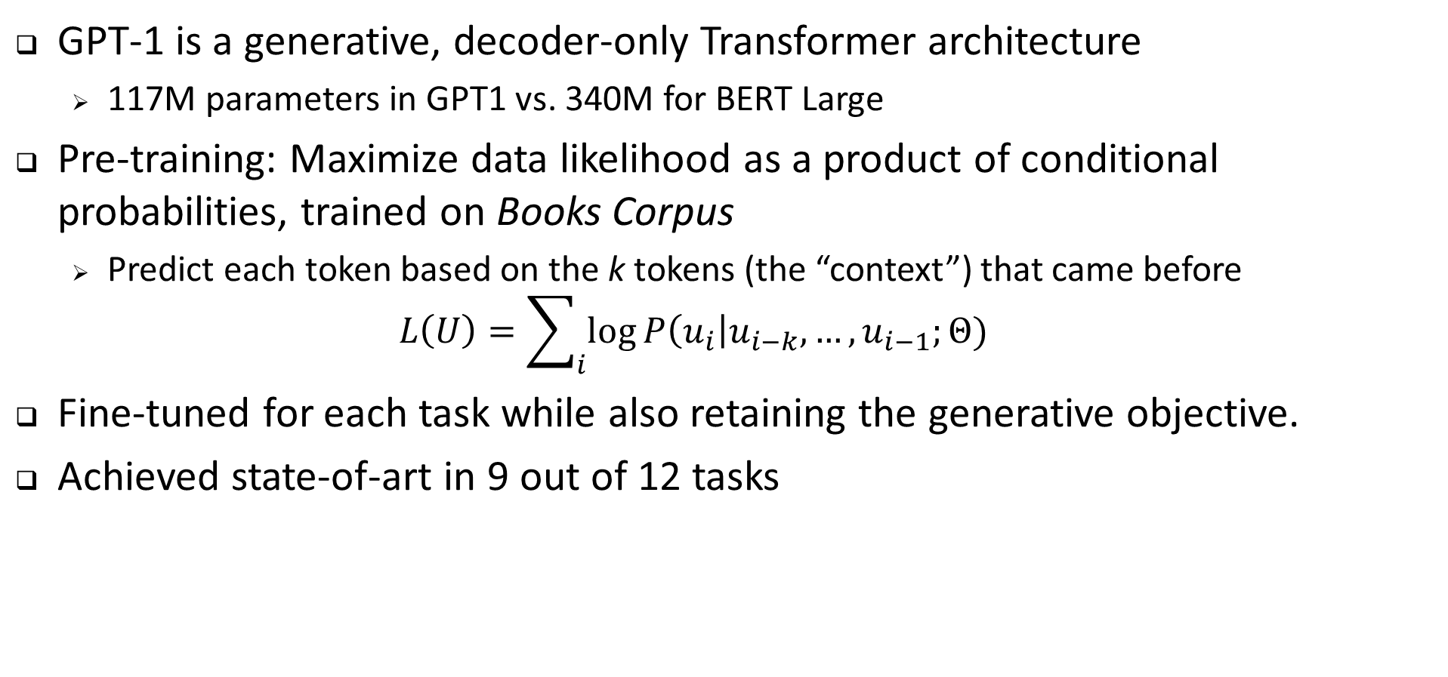
OpenAI GPT-1
GPT-1 is a generative, decoder-only Transformer architecture
  117M parameters in GPT1 vs. 340M for BERT Large
Pre-training: Maximize data likelihood as a product of conditional probabilities, trained on Books Corpus
  Predict each token based on the k tokens (the “context”) that came before
  $$L\left(U\right)=\sum_{i}{\log{P\left(u_{i}\right|u_{i−k},…, u_{i−1};Θ) }}$$
Fine-tuned for each task while also retaining the generative objective.
Achieved state-of-art in 9 out of 12 tasks

Slide 6
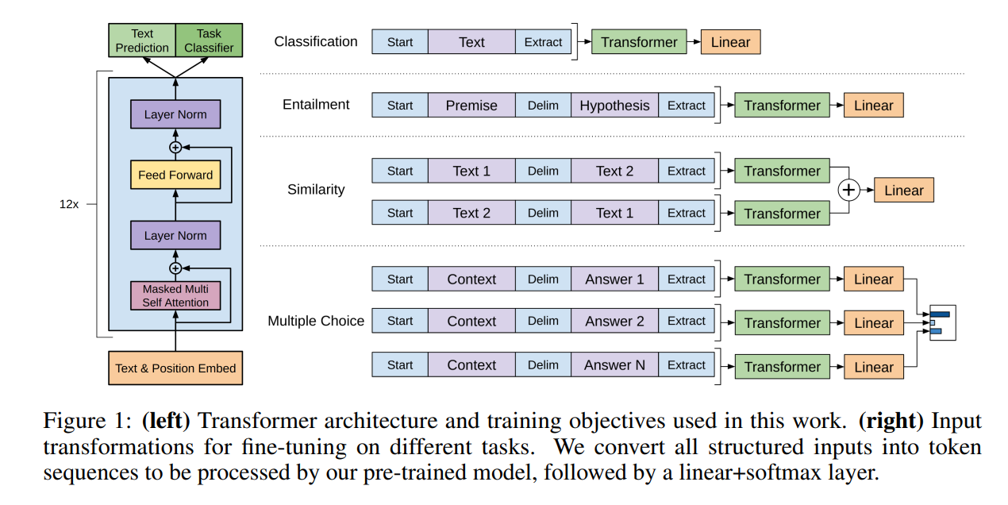
GPT1 fine-tunes linear layers for each task

Slide 7
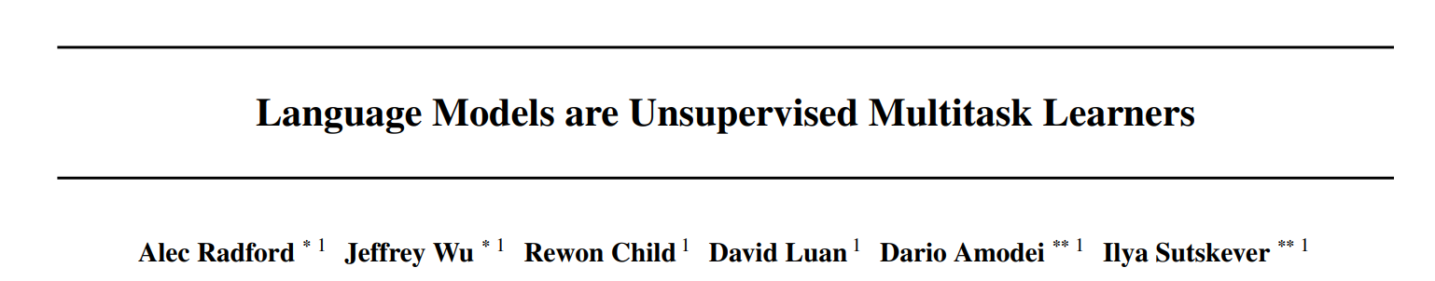
https://d4mucfpksywv.cloudfront.net/better-language-models/language-models.pdf

Slide 8
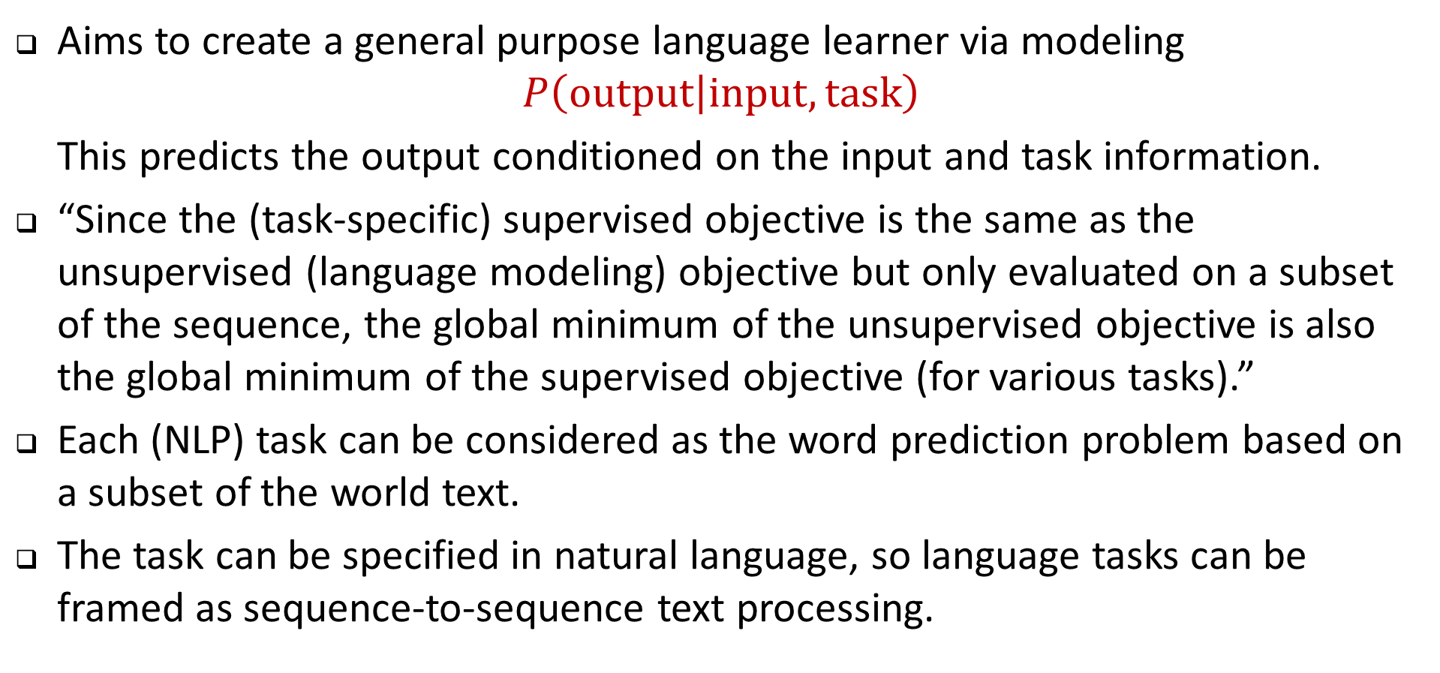
OpenAI GPT-2
Aims to create a general purpose language learner via modeling
$$P\left(output | input, task\right)$$
This predicts the output conditioned on the input and task information.
“Since the (task-specific) supervised objective is the same as the unsupervised (language modeling) objective but only evaluated on a subset of the sequence, the global minimum of the unsupervised objective is also the global minimum of the supervised objective (for various tasks).”
Each (NLP) task can be considered as the word prediction problem based on a subset of the world text.
The task can be specified in natural language, so language tasks can be framed as sequence-to-sequence text processing.
Source: Radford et al. “Language Models are Unsupervised Multitask Learners,” 2019.

Slide 9
OpenAI GPT-2: Data and Training
WebText Dataset: Created a new web scrape of pages linked from Reddit with at least 3 karma, as these should be of reasonable quality.
  Does not require additional manual annotation.
  Yields 8 million documents (40GB text) from before 2018 after de-duplication and cleaning.
  Removed Wikipedia, since it is commonly used in test sets.
GPT-2 is generatively trained on WebText data and not fine-tuned on anything else .

Slide 10
OpenAI GPT-2 Architecture and Model Sizes
Architecture is basically the same as GPT-1 and BERT
GPT-1 Size
BERT Size

Slide 11
OpenAI GPT-2: Zero shot results
Achieves state-of-art in many tasks without tuning for them
Performs much worse than state-of-art in summarization and translation (though can effectively translate word for word)
Notes:
The Children’s Book Test (CBT) (Hill et al., 2015) was created to examine the performance of LMs on different categories of words: named entities, nouns, verbs, and prepositions. Rather than reporting perplexity as an evaluation metric, CBT reports accuracy on an automatically constructed cloze test where the task is to predict which of 10 possible choices for an omitted word is correct.
The LAMBADA dataset (Paperno et al., 2016) tests the ability of systems to model long-range dependencies in text. The task is to predict the final word of sentences which require at least 50 tokens of context for a human to successfully predict.

Slide 13
Continued log-linear improvement with model size
“The diversity of tasks the model is able to perform in a zero-shot setting suggests that high-capacity models trained to maximize the likelihood of a sufficiently varied text corpus begin to learn how to perform a surprising amount of tasks without the need for explicit supervision.”

Slide 14
GPT-3 (Brown et al. 2020)
https://arxiv.org/abs/2005.14165

Slide 15
GPT-3
Although GPT-2 is intended to be an “unsupervised multitask learner”, it overall has an inferior performance compared with supervised fine-tuning state-of-the-art methods.

Slide 16
Models and Architectures

Slide 17
Training data

Slide 18
Training compute
List price of compute to train GPT-3 175B: ~$4.5M

Slide 19
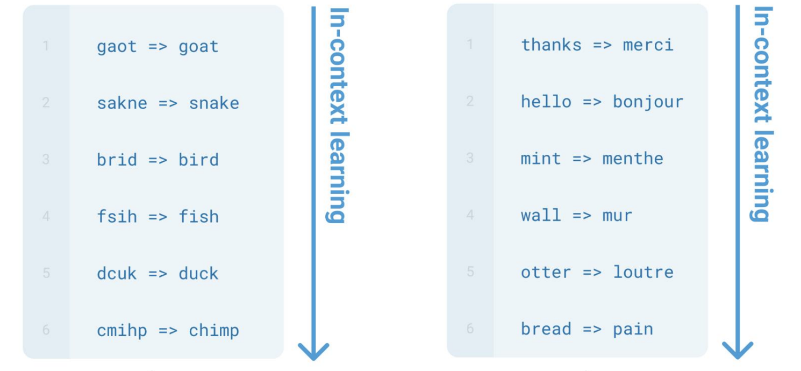
Emergent in-context learning
Specify a task by simply prepending examples of the task before your example
Also called in-context learning, to stress that no gradient updates are performed when learning a new task (there is a separate literature on few-shot learning with gradient updates)

Slide 20
GPT-3
GPT-2 scale
Accuracy on a simple task to remove random symbols from a word

Slide 21
GPT-3

Slide 22
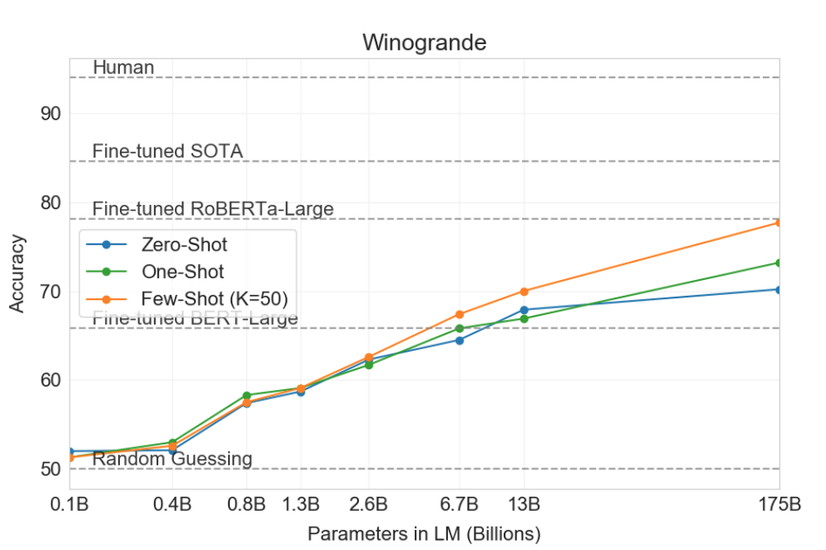

Slide 23
SuperGLUE
Average performance of few-shot is about the same as fine-tuned BERT-Large, but varies by task
Per-task specialized SOTA models are still best

Slide 25
GPT-3 Arithmetic

Slide 27
GPT-3 results summary
Great results in many NLP benchmarks
“GPT-3 also displays one-shot and few-shot proficiency at tasks designed to test rapid adaption or on-the-fly reasoning, which include unscrambling words, performing arithmetic, and using novel words in a sentence after seeing them defined only once”
GPT-3 can generate synthetic news articles which human evaluators have difficulty distinguishing from human-generated articles
Tasks where GPT-3 struggles include natural language inference tasks like the ANLI dataset, and some reading comprehension datasets like RACE or QuAC.

Slide 28
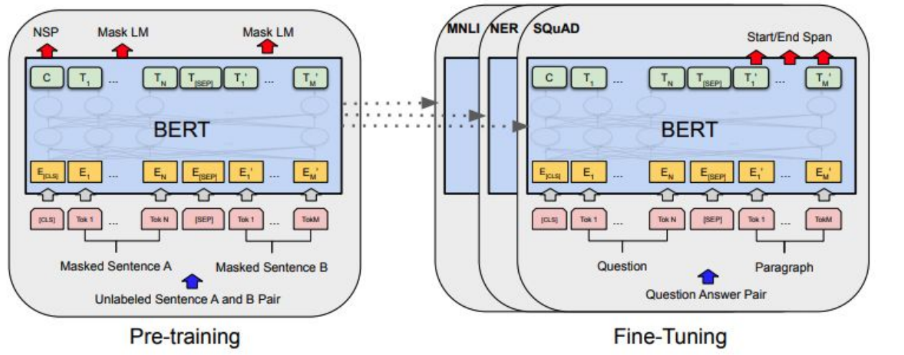

Slide 29
Limitations of Pretraining → Fine-tuning
Practical issues
  Needs large task-specific datasets
  A copy of model for each task
Potential to exploit spurious correlations
  Models can overfit to training distributions and don’t generalize to out of distribution datasets
  Learning datasets and not the underlying task
Humans don’t need large supervised datasets
  we learn from few examples and/or an instruction
  we switch between tasks easily

Slide 31
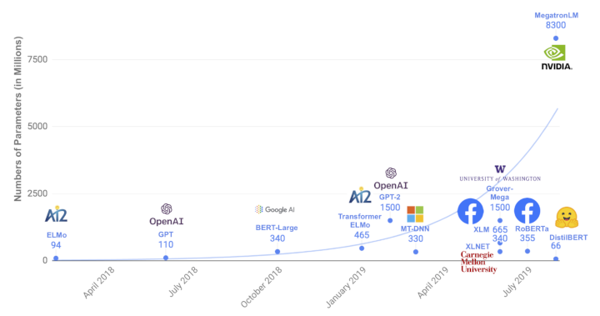
Scale in #parameters

Slide 32
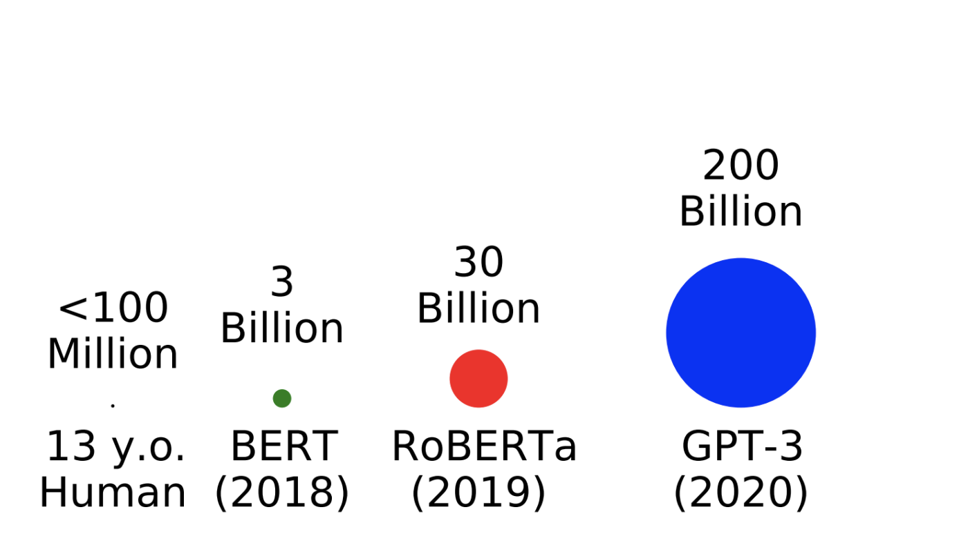
Scale in #words
#tokens seen during training

Slide 33
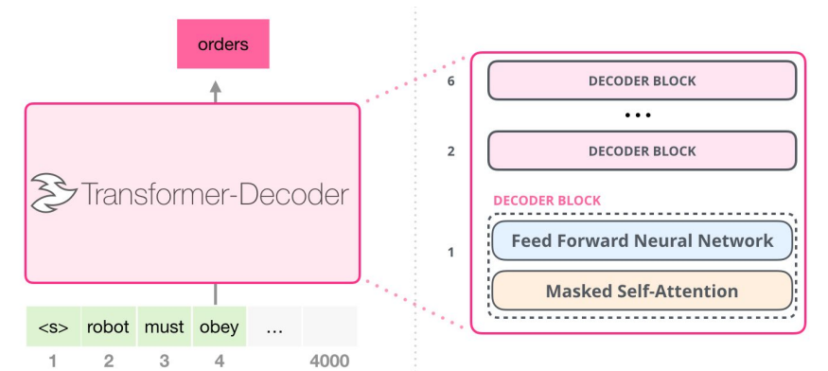
jalammar.github.io

